Slide 1

Sampling, Standardization, and Calibration

Slide 2


Sampling is one of the most important operations in a chemical analysis.
Chemical analyses use only a small fraction of the available sample. The fractions of the samples that are collected for analyses must be representative of the bulk materials.
Knowing how much sample to collect and how to further subdivide the collected sample to obtain a laboratory sample is vital in the analytical process.
All three steps of sampling, standardization, and calibration require a knowledge of statistics.

Slide 3
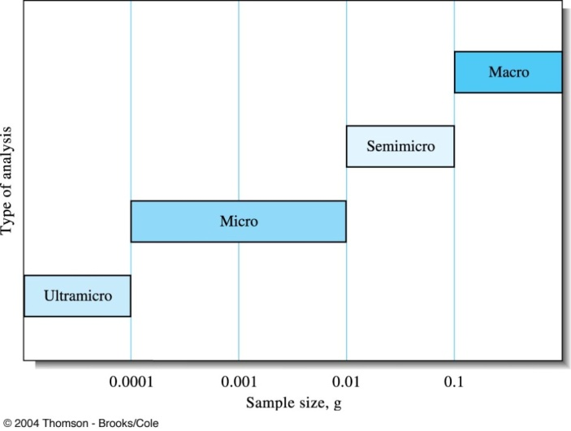
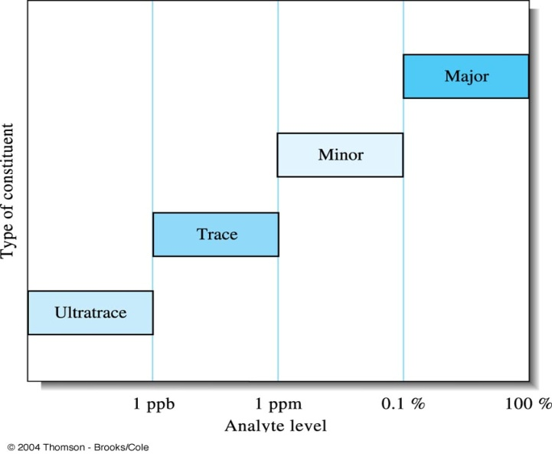
Analytical samples and methods
Sample size Type of analysis
> 0.1g Macro
0.01~0.1g Semimicro
0.0001~0.01g Micro
< 10^{–4} g Ultramicro
Analytical level Type of constituent
1%~100% Major
0.01%(100ppm)~1% Minor
1ppb~100ppm Trace
<1 ppb Ultratrace

Slide 4
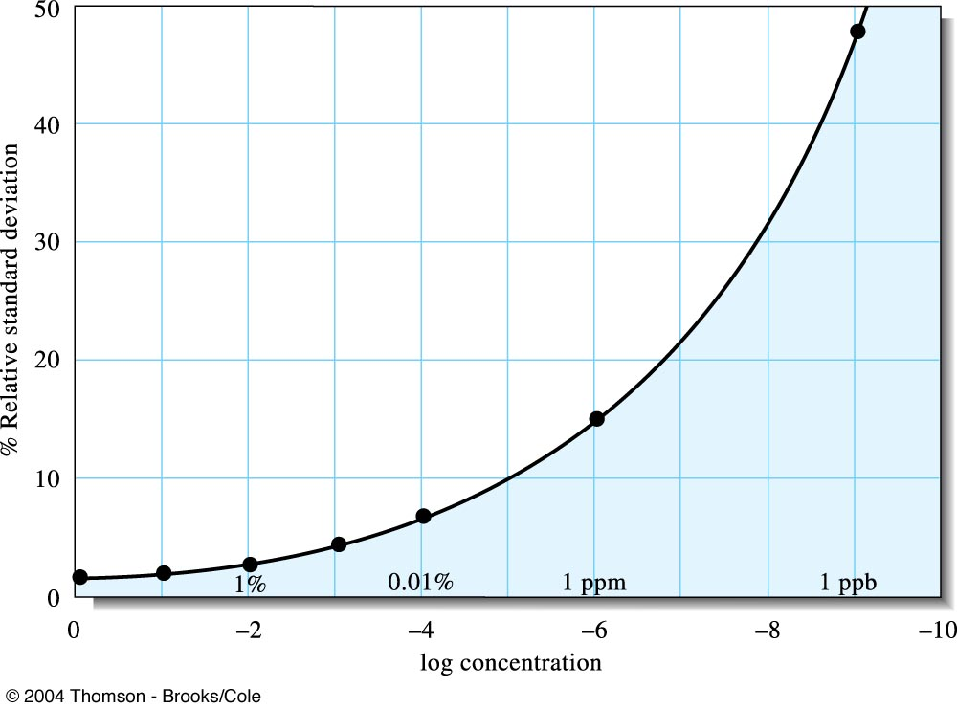
Interlaboratory error as a function of analyte concentration. Note that the relative standard deviation dramatically increase as the analyte concentration decreases.
W. Horowitz, Anal. Chem., 1982, 54, 67A-76A.

Slide 5
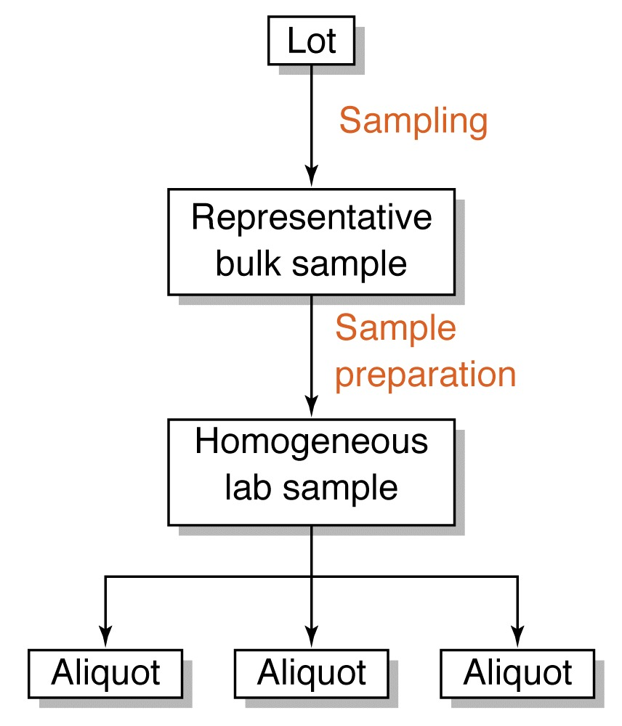
Steps in obtaining a lab sample
Identify the population
Collect a gross sample
Reduce the gross sample to a lab sample
Lab sample may constitute as little as 1 part in 10⁷ or 10⁸ of the bulk material.

Slide 6
Sampling
Sampling is the process of extracting from a large quantity of material a small portion, which is truly representative of the composition of the whole material.
Three main methods sampling:
Census : all the material is examined ⇒ impracticable
Casual sampling on an ad hoc basis ⇒ unscientific
Statistical sampling

Slide 7
Census vs Random sampling
Census
A complete enumeration, usually of a population, but also businesses and commercial establishments, farms, governments, and so forth.
A complete study of the population as compared to a sample.
Random sampling
A commonly used sampling technique in which sample units are selected so that all combinations of n units under consideration have an equal chance of being selected as the sample.
(Statistical sampling) A sampling method in which every possible sample has the same chance of being selected.

Slide 8
Sampling statistics
Total error = sampling error + analytical error
s_{T} = ( s_{S}² + s_{A}² )^{1/2}
In designing a sampling plan the following points should be considered.
the number of samples to be taken
the size of the sample
should individual samples be analysed or should a sample composed of two or more increments (composite) be prepared.

Slide 9
Sampling uncertainties
Both systematic and random errors in analytical data can be traced to instrument, method, and personal causes.
Most systematic errors can be eliminated by exercising care, by calibration, and by the proper use of standards, blanks, and reference materials.
For random and independent uncertainties, the overall standard deviation s₀ for an analytical measurement is related to the standard deviation of the sampling process s_{s} and the standard deviation of the method s_{m} by the relationship
s₀² = s_{s}² + s_{m}²
When s_{m}< s_{s}/3, there is no point in trying to improve the measurement precision.

Slide 10
Size of the gross sample
Basically, gross sample weight is determined by
The uncertainty that can be tolerated between the composition of the gross sample and that of the whole,
The degree of heterogeneity of the whole,
The level of particle size at which heterogeneity begins.
To obtain a truly representative gross sample, a certain number N of particles must be taken. The number of particles required in a gross sample ranges from a few particles to 10¹² particles.

Slide 11
Standardization and calibration
Standardization is the process of experimentally determining the relationship between the signal and the amount of analyte
For a total analysis method, standardization is usually defined by the stoichiometry of the chemical reactions responsible for the signal
For a concentration method, however, the relationship between the signal and the analyte’s concentration is a theoretical function that cannot be calculated without experimental measurements

Slide 12
Standardization and Calibration
Measurements with any analytical method or instrument requires calibration to ensure the accuracy of the measurement
Calibration is the process of ensuring that the signal
measured by a piece of equipment or an instrument is correct.
There are two common calibration procedures: using a working curve, and the standard-addition method.
Both of these methods require one or more standards of known composition to calibrate the measurement
Gravimetric methods and some coulometric methods are among the few absolute methods that do not rely on calibration with chemical standards

Slide 13
Calibration methods
Comparison with standards
External standard calibration
Internal standard methods
Standard addition methods

Slide 14
Calibration methods
The main advantage of the working curve method is that it is rapid in that a single set of standards can be used for the measurement of multiple samples.
The standard-addition method requires multiple measurements for each sample, but can reduce inaccuracies due to interferences and matrix effects.
Instrumental methods are usually calibrated with standards that are prepared (or purchased) using a non-instrumental analysis. There are two direct analytical methods: gravimetry and coulometry. Titration is similar but requires preparation of a primary standard.

Slide 15
Solutions
Standard solutions
solutions containing known concentrations of analyte.
Blank solutions
solutions containing all the reagents and solvents used in the analysis, but not deliberately added analyte
Solvent blank : containing the same solvent
Reagent blank : containing the solvent plus all the reagents

Slide 16
Working Curve method
The working curve is also called the calibration curve
The experimenter prepares a series of standards across the range of concentrations that are of interest
Care is taken such that these concentrations are in the detection range of the technique (instrumentation) they are using
These standards have a precisely known concentration of the element or compound under study
Each of these standards is analysed several times using the chosen technique to produce a series of readings, each set indicative of one of the known concentrations

Slide 17
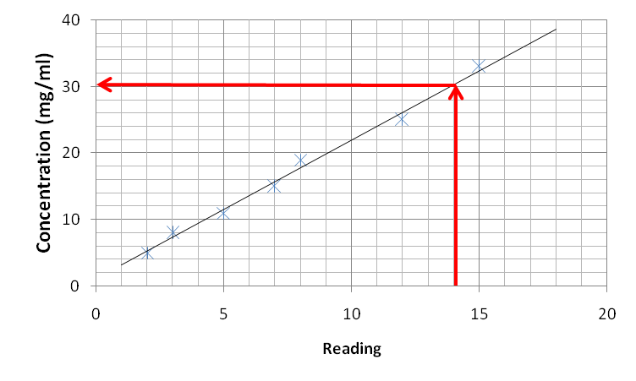
Working Curve method
By plotting these points (reading vs concentration) on a graph, it is possible to plot a line of reading vs concentration across the detection range of that technique
Thus, when the sample is run and a reading obtained, the experimenter can simply refer to the graph to read off the concentration.

Slide 18
Working Curve method
If the concentration of element or compound in the sample is too high for the detection range of the technique, it can simply be diluted in a pure solvent
If the amount in the sample is below an instrument's range of measurement, the method of addition can be used
In this method a known quantity of the element or compound under study is added, and the difference between the concentration added, and the concentration observed is the amount actually in the sample

Slide 19
Linear regression
Linear regression uses the method of least squares to determine the best linear equation to describe a set of x and y data points
The method of least squares minimizes the sum of the square of the residuals - the difference between a measured data point and the hypothetical point on a line
The residuals must be squared so that positive and negative values do not cancel
A common application of linear regression in analytical chemistry is to determine the best linear equation for calibration data to generate a calibration or working curve
The concentration of an analyte in a sample can then be determined by comparing a measurement of the unknown to the calibration curve

Slide 20
Standard Addition Methods
Due to matrix effects the analytical response for an analyte in a complex sample may not be the same as for the analyte in a simple standard
In this case, calibration with a working curve would require standards that closely match the composition of the sample
For diverse and one-of-a-kind samples, this procedure is time consuming and often impossible
An alternative calibration procedure is the standard addition method

Slide 21
Standard addition method
An analyst usually divides the unknown sample into two portions, so that a known amount of the analyte (a spike) can be added to one portion
These two samples, the original and the original plus spike, are then analyzed
The sample with the spike will show a larger analytical response than the original sample due to the additional amount of analyte added to it
The difference in analytical response between the spiked and unspiked samples is due to the amount of analyte in the spike
This provides a calibration point to determine the analyte concentration in the original sample

Slide 22
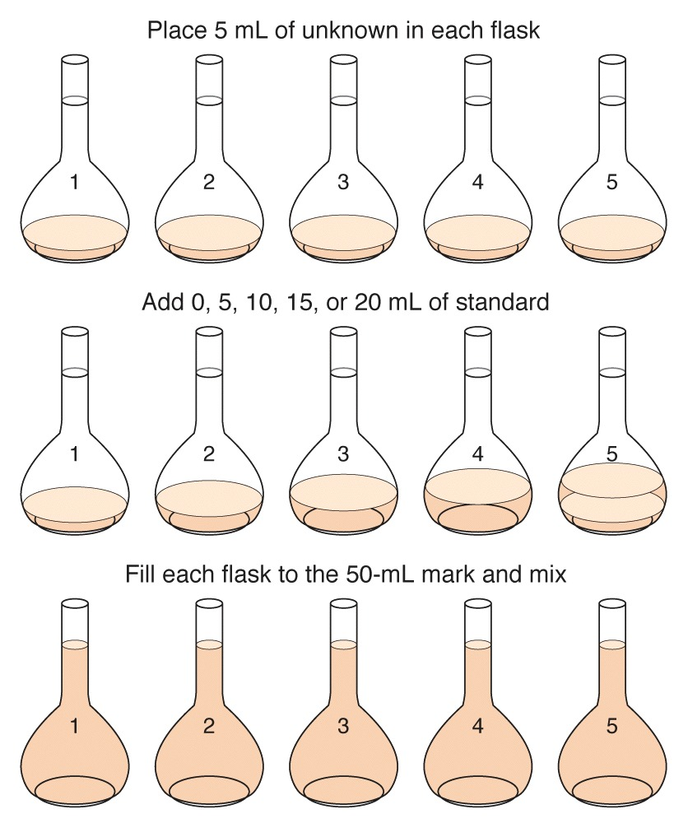
Standard addition experiment

Slide 23
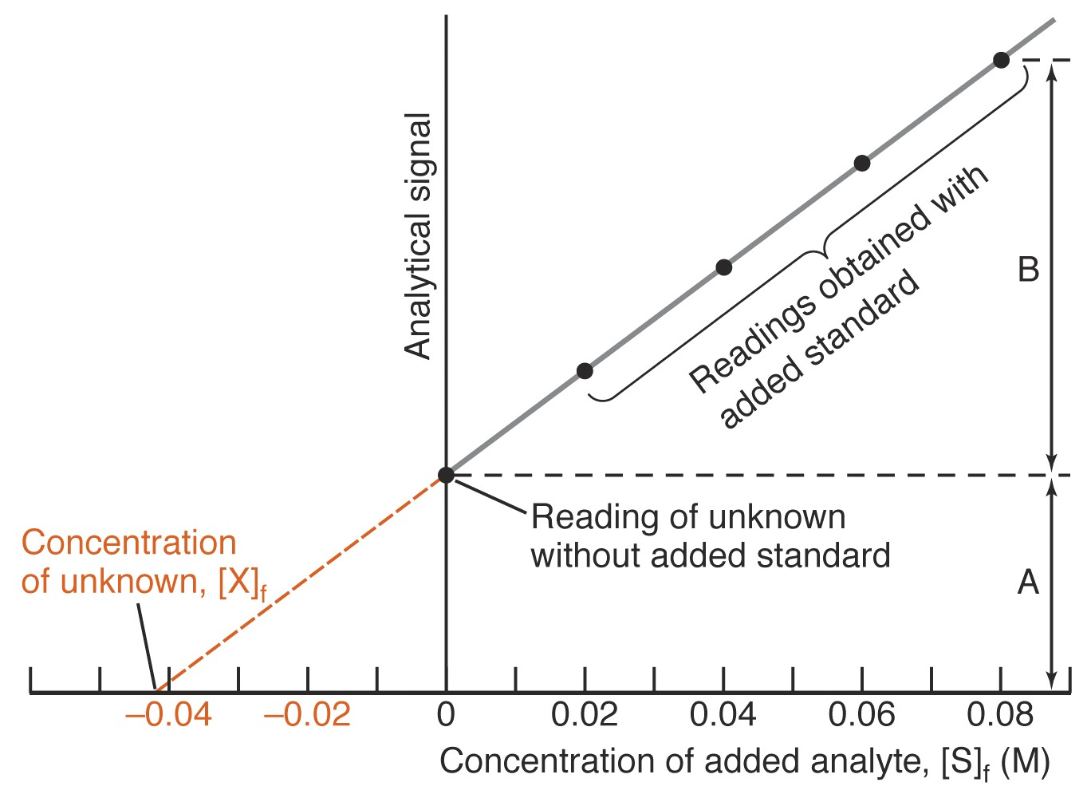
Graphical treatment of standard addition experiment.

Slide 24
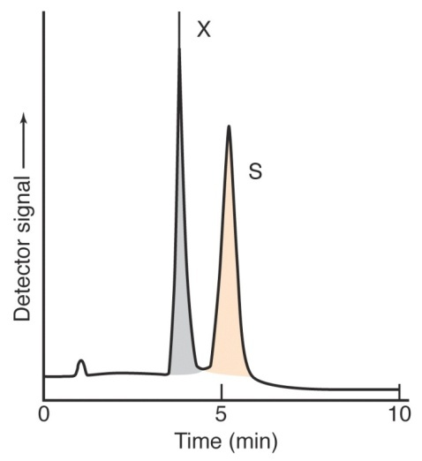
Internal standard methods
An internal standard method is a reference species, chemically and physically similar to the analyte, that is added to samples, standards, and blanks
The ratio of the response of the analyte to that of the internal standard is plotted versus the concentration of analyte
Signal
[X] / [IS]
Illustration of the internal standard method

Slide 25
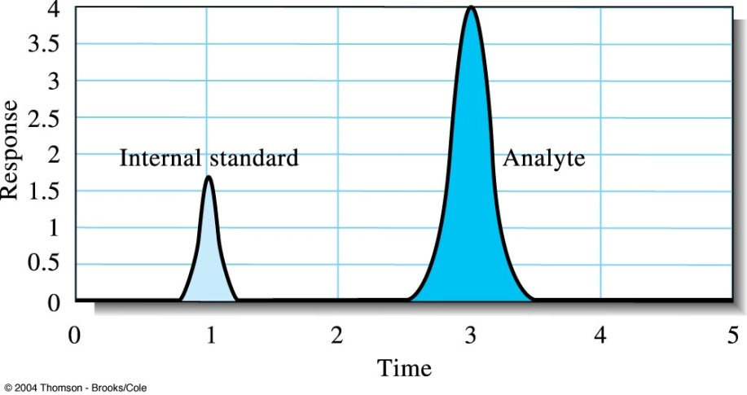
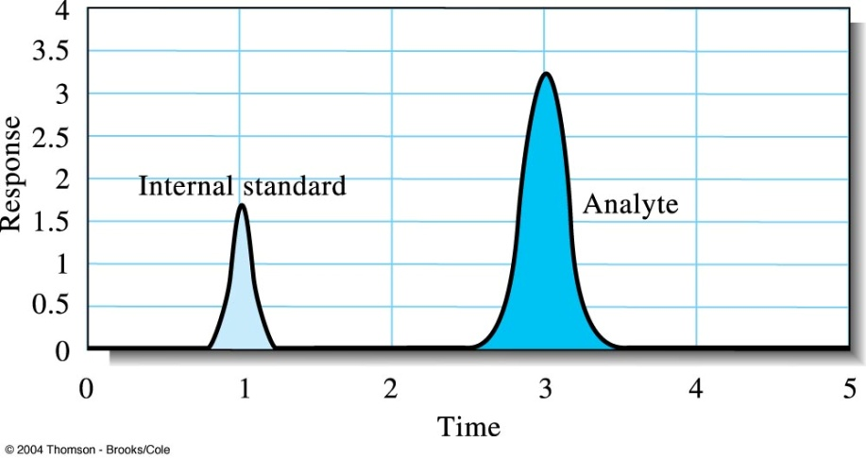
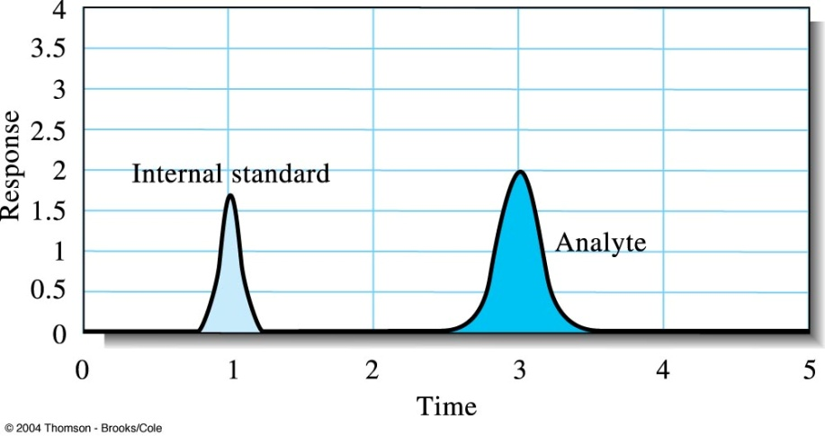
Illustration of the internal standard method.

Slide 26
Gravimetric Methods of Analysis

Slide 27
Gravimetry
Gravimetric methods are quantitative methods that are based on determining the mass of pure compound to which the analyte is chemically related.
Precipitation gravimetry: the analyte is separated from a solution of the sample as a precipitate and is converted to a compound of known composition that can be weighed. The precipitant is a reagent that causes the precipitation of a soluble species.
Volatilization gravimetry: the analyte is separated from other constituents of a sample by conversion to a gas of known chemical composition. The weight of this gas then serves as a measure of the analyte concentration.

Slide 28
Gravimetry
Electrogravimetry: the analyte is separated by deposition on an electrode by electrical current. The mass of this product then provides a measure of the analyte concentration.
Atomic mass spectrometry: use a mass spectrometer to separate the gaseous ions formed from the elements making up a sample of matter. The concentration of the resulting ions is then determined by measuring the electrical current produced when they fall on the surface of an ion detector.

Slide 29
Procedure for gravimetry based on precipitation
1) Preparation of sample solution
2) Precipitation : Gravimetric precipitating agent should react specifically or at least selectively with the analyte.
rR + aA = R_{r}A_{a} (solid)
3) Digestion
4) Filtration and washing
5) Drying, ignition and weighing
6) Computation of results

Slide 30
Ex. Precipitation method for determining calcium in natural water
2NH₃ + H₂(COO)₂ → 2NH₄⁺ + (COO)₂^{2–}
Ca²⁺ + (COO)₂^{2–} → Ca(COO)₂ (s)
Ca(COO)₂ (s) → CaO (s) + CO (g) + CO₂ (g)
Δ

Slide 31
Examples of gravimetry
Ag⁺ + Cl– = AgCl
[Cl – ] = ?
Ag⁺ + Cl– = AgCl
1 mol 1 mol 1 mol = 143.321g
x x mol = 0.4368g
x = 3.048 ×10^{–3}mol
[Cl– ] = 3.048 ×10^{–3} mol / 10.00ml
= 0.3048 M
Excess AgNO₃
AgCl
0.4368 g
10.00 ml Cl–

Slide 32
Properties of Precipitates and Precipitating Reagents
Requirements of the ideal product of a gravimetry :
1) very insoluble
2) easily filterable : large crystal particle
3) very pure
4) known and constant composition

Slide 33
Solubility effects
An accurate precipitation gravimetric method requires
that the precipitate’s solubility be minimal
Many total analysis techniques can routinely
be performed with an accuracy of better than ±0.1%
To obtain a high level of accuracy, the isolated precipitate must account for at least 99.9% of the analyte.

Slide 34
Solubility effects
Solubility losses are minimized by carefully controlling the composition of the solution in which the precipitate forms
This requires an understanding of the relevant equilibrium reactions affecting the precipitate’s solubility
For example, Ag+ can be determined gravimetrically by adding Cl– as a precipitant, forming a precipitate of AgCl
Ag⁺(aq) + Cl–(aq) AgCl(s)

Slide 35
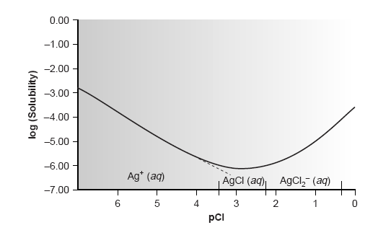
Clearly the equilibrium concentration of chloride is an important parameter if the concentration of silver is to be determined gravimetrically by precipitating AgCl. In
particular, a large excess of chloride must be avoided.

Slide 36
Effect of pH
Another important parameter that may affect a precipitate’s solubility is the pH of the solution in which the precipitate forms
For example, hydroxide precipitates, such as Fe(OH)₃, are more soluble at lower pH levels at which the concentration of OH– is small.
The effect of pH on solubility but also affects precipitates containing basic or acidic ions

Slide 37

pH of solution
The solubility of Ca₃(PO₄)₂ is pH-dependent because phosphate is a weak base. The following four reactions, therefore, govern the solubility of Ca₃(PO₄)₂.
Ca₃(PO₄)₂(s) 3Ca²⁺(aq) + 2PO₄^{3–}(aq)
PO₄^{3–}(aq) + H₂O(l) HPO₄^{2–}(aq) + OH–(aq)
HPO₄ ^{2–}(aq) + H₂O(l) H₂PO₄–(aq) + OH–(aq)
H₂PO₄–(aq) + H₂O(l) H₃PO₄(aq) + OH–(aq)
Depending on the solution’s pH, the predominant phosphate species is either PO₄^{3–},HPO₄ ^{2–}, H₂PO₄–, or H₃PO₄

Slide 38
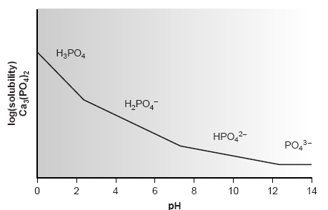
Solubility diagram for Ca₃(PO₄)₂ showing the predominant form of phosphate for each segment of the solubility curve.

